Slide 1

Today’s Lesson:
What:
probability of simple events
Aim:
Calculate the probability of simple events
Compare theoretical probability and experimental probability.

Slide 2
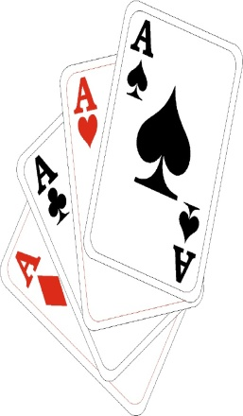

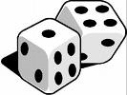
Vocabulary:
Probability– expressed as a ratio describing the # of ___________________ outcomes to the # of _______________ outcomes. Probability is measured on a scale from 0 – 1.
Theoretical Probability– the probability, based on ______________________, that an event will occur (what should happen).
Experimental Probability– found using outcomes obtained in an actual _________________ or game (what actually happens).
What SHOULD happen v. What ACTUALLY happens!
favorable
total
math
experiment

Slide 3

Equally
Likely
Impossible
Certain
0
$$\frac{1}{2}$$
1
Unlikely
Likely
Where would the following fall on the above Number Line???
Your parents will win a lottery jackpot this year.
Food will be served for lunch.
The sun will rise tomorrow.
You will have 2 birthdays this year.
You will see a cat this evening.
6) You will roll a “2” on a standard number cube.
On your way to school, you will see a live woolly mammoth.
8) You will see a wild, living black bear tomorrow.
You will get tails when you flip a coin.
You will become famous one day.

Slide 4

“So, you’re saying there’s a chance . . .”

Slide 5
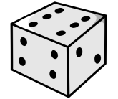
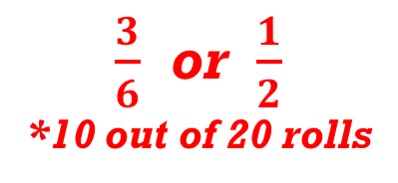
TRIAL #1: Rolling a Number Cube Out of 20 trials, how many times will an odd number occur– P (odd #)?
What do we need to know? # of odd #’s: _____ total # of sides: _____ | 2) Theoretical Probability:
Do the experiment (20 trials): | 4) Experimental Probability:
3
(what should happen)
6
$\frac{3}{6}$ or $\frac{1}{2}$
*10 out of 20 rolls
(what actually happens)

Slide 6
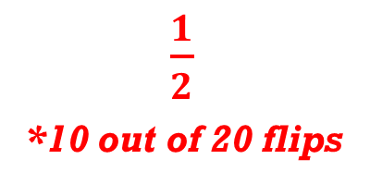
TRIAL #2: Flipping a Coin Out of 20 trials, how many times will heads occur– P(heads)?
What do we need to know? # of heads: _____ total # of sides: _____ | 2) Theoretical Probability:
Do the experiment (20 trials): | 4) Experimental Probability:
1
(what should happen)
$\frac{1}{2}$
*10 out of 20 flips
2
(what actually happens)

Slide 7

Quick notes
$$Probability of an event= \frac{number of favourable outcomes}{total number of outcomes}$$
Or mathematically stated as:
$$P\left(event\right)= \frac{favourable oucomes}{total outcomes}$$

Slide 8








How many Smarties are there altogether?
20

Slide 9

All the Smarties are put back in the tube.
If I pick a Smartie at random, what is the probability that it is green?
Total number of Smarties =
20
Number of green Smarties = 1
1
Probability of picking green =
20

Slide 10
All the Smarties are in the tube.
If I pick a Smartie at random, what is the probability that it is brown?
Total number of Smarties =
20
Number of brown Smarties = 4
4
Probability of picking brown =
20
1
=
5

Slide 11
All the Smarties are in the tube.
If I pick a Smartie at random, what is the probability that it is orange or yellow?
Total number of Smarties =
20
Number of orange
and yellow Smarties = 7
Probability of picking
orange or yellow =
7
20

Slide 12
All the Smarties are in the tube.
If I pick a Smartie at random, what is the probability that it is not blue?
Total number of Smarties =
20
Number of not blue
Smarties = 17
Probability of not
picking blue =
17
20

Slide 13
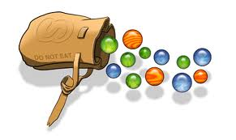
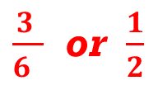
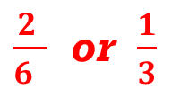

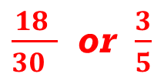
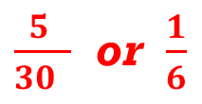

SAMPLE Probability Questions:
A bag contains 7 blue, 5 purple, 12 red, and 6 orange marbles. Find each probability if you draw one marble at random from the bag. Write as a fraction in simplest form.
a) P(purple) b) P(red or orange) c) P(not blue)
You roll a standard number cube (six sides numbered 1 – 6). After one roll, answer the following:
a) P(3 or 4) b) P(even #) c) P(not 2)
$\frac{5 }{30 }$ or $\frac{1}{6}$
$\frac{18 }{30 }$ or $\frac{3}{5}$
$$\frac{23 }{30 }$$
$\frac{2 }{6 }$ or $\frac{1}{3}$
$\frac{3 }{6 }$ or $\frac{1}{2}$
$$\frac{5 }{6 }$$

Slide 14

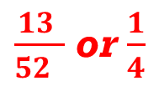


Fill in the following information about a standard deck of cards:
TOTAL # of Cards: _____
# of Hearts(♥): _____
# of Diamonds(♦): _____
# of Clubs(♣): _____
# of Spades(♠): _____
# of Red Cards: _____
# of Black Cards: _____
Cards in Each Suit: _______
Now, given the above, answer the following:
a) P(Ace) b) P(red card) c) P(Red King) d) P(Club)
52
13
13
13
13
26
26
13
$\frac{4 }{52 }$ or $\frac{1}{13}$
$\frac{26 }{52 }$ or $\frac{1}{2}$
$\frac{2 }{52 }$ or $\frac{1}{26}$
$\frac{13 }{52 }$ or $\frac{1}{4}$

Slide 15
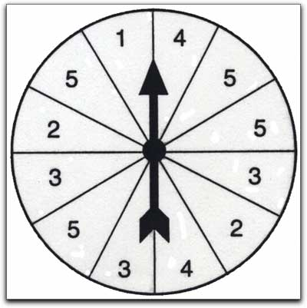
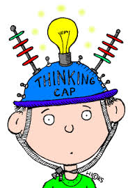
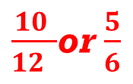
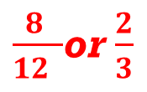
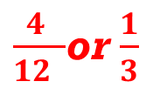
Given the spinner to the right, answer the following:
a) P(5) b) P(odd #) c) P(2 or an odd #)
$\frac{4 }{12 }$or $\frac{1}{3}$
$\frac{8 }{12 }$or $\frac{2}{3}$
$\frac{10 }{12 }$or $\frac{5}{6}$

Slide 16
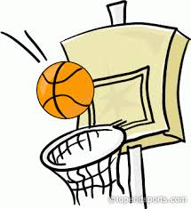

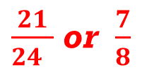
Sample “Experimental” Probability Questions:
Mike was practicing basketball shots. Out of 24 attempts, he made 21 baskets. Based on this rate, what is the probability that Mike’s next shot will go in the basket?
Jane was throwing darts. Out of 12 attempts, 3 were bulls-eyes. If Jane were to make 36 attempts, how many should be bulls-eyes?
$\frac{21}{24 }$ or $\frac{7}{8}$
9

Slide 17

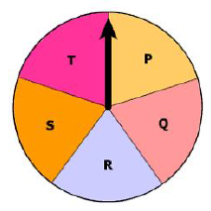
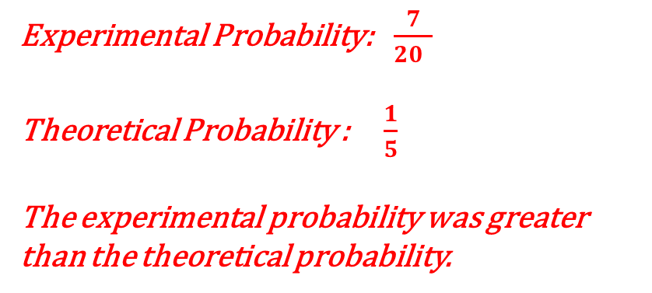
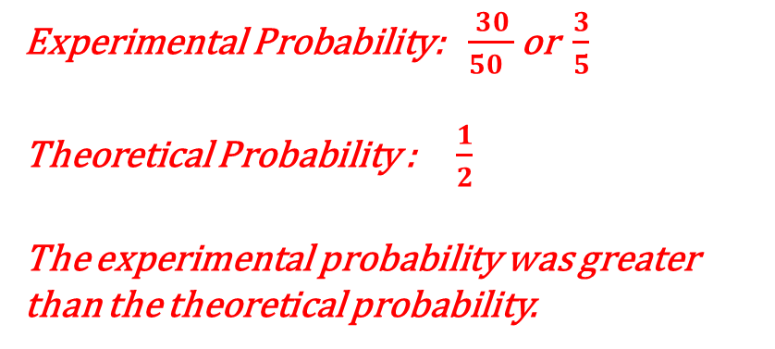
A coin was flipped fifty times. Out of 50, it landed on heads 30 times. What is the experimental probability that the coin will land on heads on the next toss? How is this different from the theoretical probability?
Experimental Probability:$\frac{30}{50 }$ or $\frac{3}{5}$
Theoretical Probability : $\frac{1}{2}$
The experimental probability was greater than the theoretical probability.
The spinner shown has 5 sections of equal size. The arrow of this spinner was spun 20 times and landed on the section labeled “R” 7 times. Compare the theoretical probability with the experimental probability of the spinner landing
on “R.”
Experimental Probability:$\frac{7}{20 }$
Theoretical Probability : $\frac{1}{5}$
The experimental probability was greater than the theoretical probability.

Slide 18
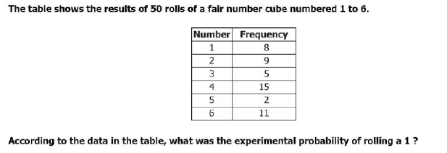
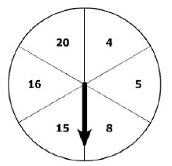
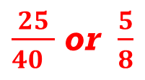
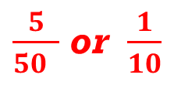
The table shown depicts the results of 50 rolls of a fair number cube numbered 1 – 6. According the table, what was the experimental probability of rolling a 3 ?
The arrow of this spinner was spun 40 times.
On 25 out of 40 times, the arrow landed on a
section labeled with a multiple of 4. What was
the experimental probability of the arrow
landing on a section labeled with a multiple
of 4?
$\frac{5}{50 }$ or $\frac{1}{10}$
$\frac{25}{40 }$ or $\frac{5}{8}$

Slide 19

END OF LESSON
The next slides are student copies of the notes for this lesson. These notes were handed out in class and filled-in as the lesson progressed.
NOTE: The last slide(s) in any lesson slideshow (entitled “Practice Work”) represent the homework assigned for that day.

Slide 20
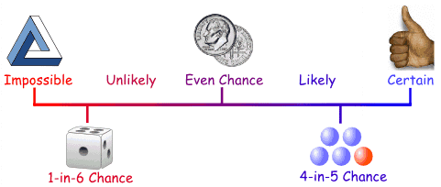

NAME:
Math-8 NOTES
DATE: ______/_______/_______
What: probability of simple events
Why: To calculate the probability of simple events and to analyze the difference
between theoretical probability and experimental probability.
Vocabulary:
Probability– expressed as a ratio describing the # of ___________________ outcomes to the # of _______________________ outcomes. Probability is measured on a scale from
0 – 1.
Theoretical Probability– the probability, based on ______________________, that an event will occur (what should happen).
Experimental Probability– found using outcomes obtained in an actual _________________ or game (what actually happens).
What SHOULD happen v. What ACTUALLY happens!
Equally
Likely
Impossible
Certain
0
$$\frac{1}{2}$$
1
Unlikely
Likely
Where would the following fall on the above Number Line???
Your parents will win a lottery jackpot this year.
Food will be served for lunch.
The sun will rise tomorrow.
You will have 2 birthdays this year.
You will see a cat this evening.
6) You will roll a “2” on a standard number cube.
7) On your way to school, you will see a live woolly mammoth.
8) You will see a wild, living black bear tomorrow.
You will get tails when you flip a coin.
You will become famous one day.

Slide 21
PROBABILITY TRIALS
TRIAL #1 : Rolling a Number Cube Out of 20 trials, how many times will an odd number occur– P (odd #)?
1) What do we need to know? # of odd #’s: _____ total # of sides: _____ | 2) Theoretical Probability:
3) Do the experiment (20 trials): | 4) Experimental Probability:
(what should happen)
(what actually happened)
TRIAL #2 : Flipping a Coin Out of 20 trials, how many times will heads occur– P(heads)?
1) What do we need to know? # of heads: _____ total # of sides: _____ | 2) Theoretical Probability:
3) Do the experiment (20 trials): | 4) Experimental Probability:
(what should happen)
(what actually happened)
Note: As the # of Trials increase, The experimental probability will come closer and closer to the theoretical probability!!

Slide 22
SAMPLE Probability Questions:
A bag contains 7 blue, 5 purple, 12 red, and 6 orange marbles. Find
each probability if you draw one marble at random from the bag. Write as a fraction in simplest form.
a) P(purple) b) P(red or orange) c) P(not blue)
2) You roll a standard number cube (six sides numbered 1 – 6). After one roll, answer the following:
a) P(3 or 4) b) P(even #) c) P(not 2)
Fill in the following information about a standard deck of cards:
TOTAL # of Cards: _____
# of Hearts(♥): _____
# of Diamonds(♦): _____
# of Clubs(♣): _____
# of Spades(♠): _____
# of Red Cards: _____
# of Black Cards: _____
Cards in Each Suit: _______
Now, given the above, answer the following:
a) P(Ace) b) P(red card) c) P(Red King) d) P(Club)
Given the spinner to the right, answer the following:
a) P(5) b) P(odd #) c) P(2 or an odd #)

Slide 23
Sample “Experimental” Probability Questions:
Mike was practicing basketball shots. Out of 24 attempts, he made 21 baskets.
Based on this rate, what is the probability that Mike’s next shot will go in the basket?
Jane was throwing darts. Out of 12 attempts, 3 were bulls-eyes. If Jane were to make 36 attempts, how many should be bulls-eyes?
A coin was flipped fifty times. Out of 50, it landed on heads 30 times. What is the experimental probability that the coin will land on heads on the next toss? How is this different from the theoretical probability?
The spinner shown has 5 sections of equal size. The arrow of this spinner was
spun 20 times and landed on the section labeled “R” 7 times. Compare the
theoretical probability with the experimental probability of the spinner landing
on “R.”
The table shown depicts the results of 50 rolls of a fair number cube
numbered 1 – 6. According the table, what was the experimental probability of
rolling a 3 ?
The arrow of this spinner was spun 40 times. On 25 out of 40 times, the arrow
landed on a section labeled with a multiple of 4. What was the experimental
probability of the arrow landing on a section labeled with a multiple of 4?

Slide 24
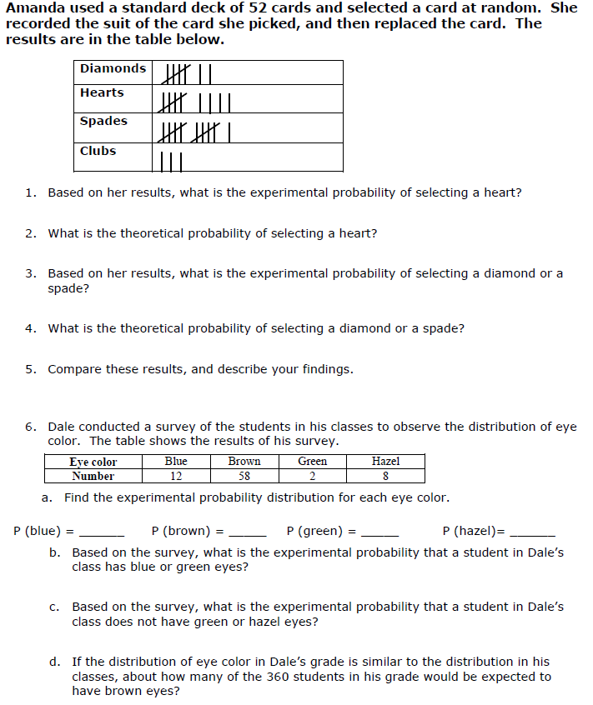
NAME:_____________________________________________________________________________
DATE: ______/_______/_______
Math-7 practice/ homework
“theoretical versus experimental probability”
First, you need to count how many times she picked a card (look at tallies).
Again, use table to count the total # of people surveyed.

Slide 25
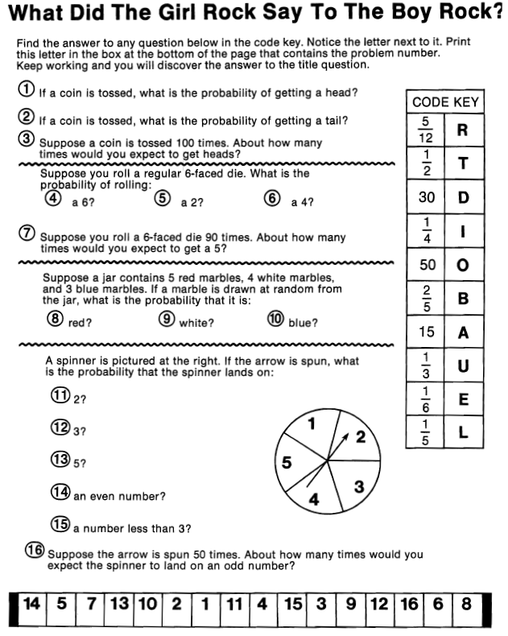
NAME:_____________________________________________________________________________
DATE: ______/_______/_______
Math-7 practice/ homework
“probability of simple events”

